Slide 1
5G Observatory Dashboard
October 2023 – Report 19
CNECT/2021/OP/0008 European 5G Observatory, Phase III

Slide 2
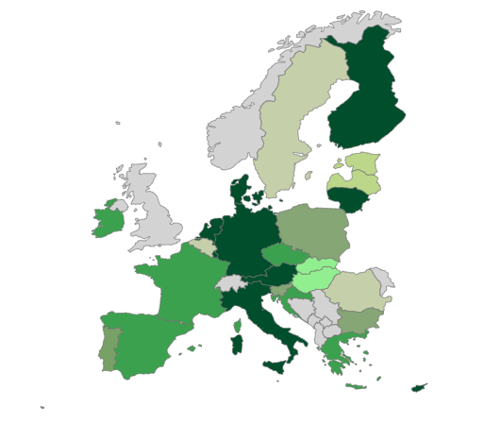
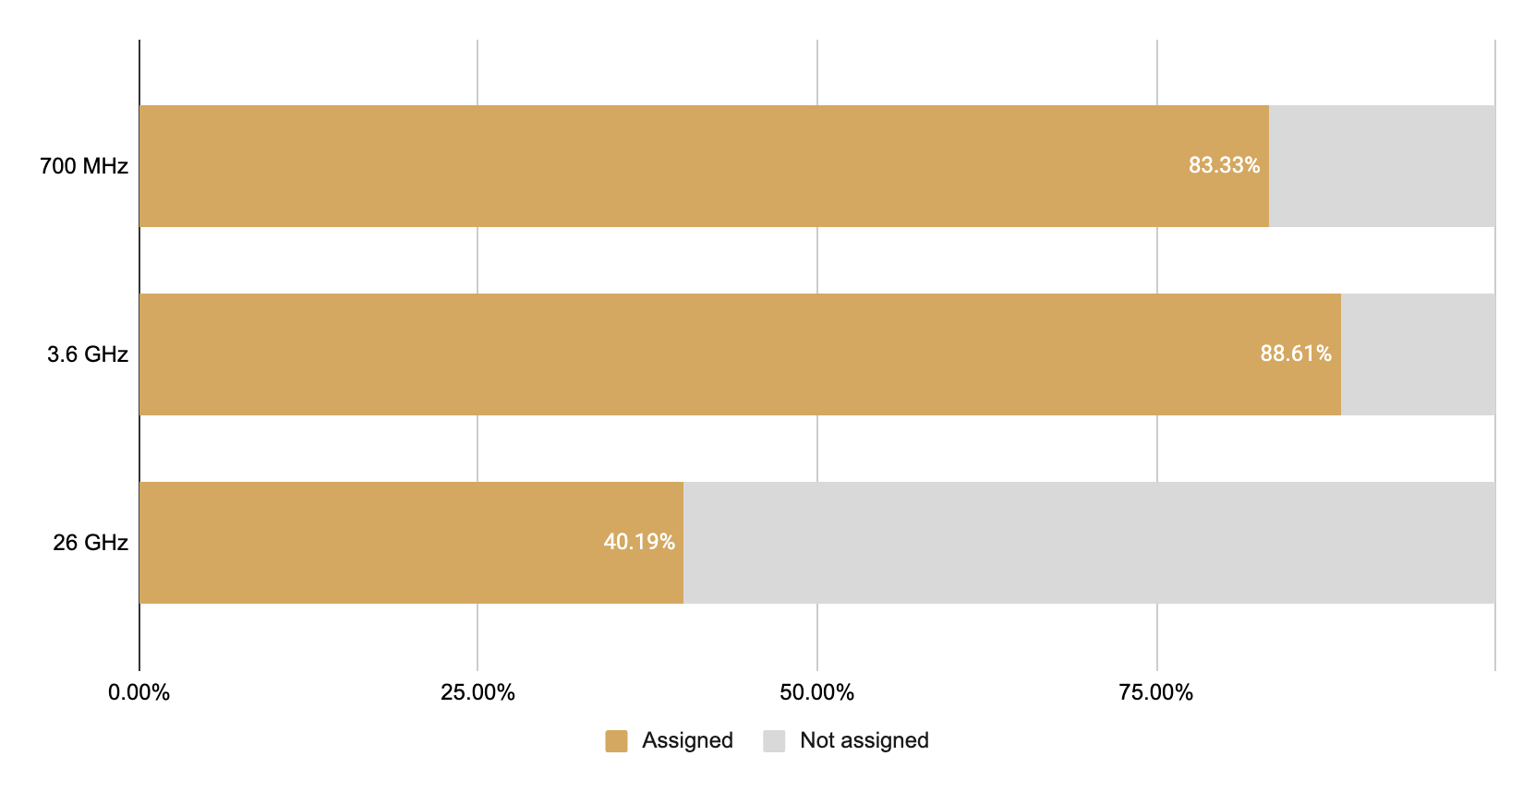
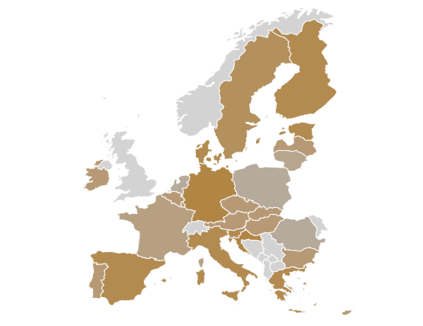
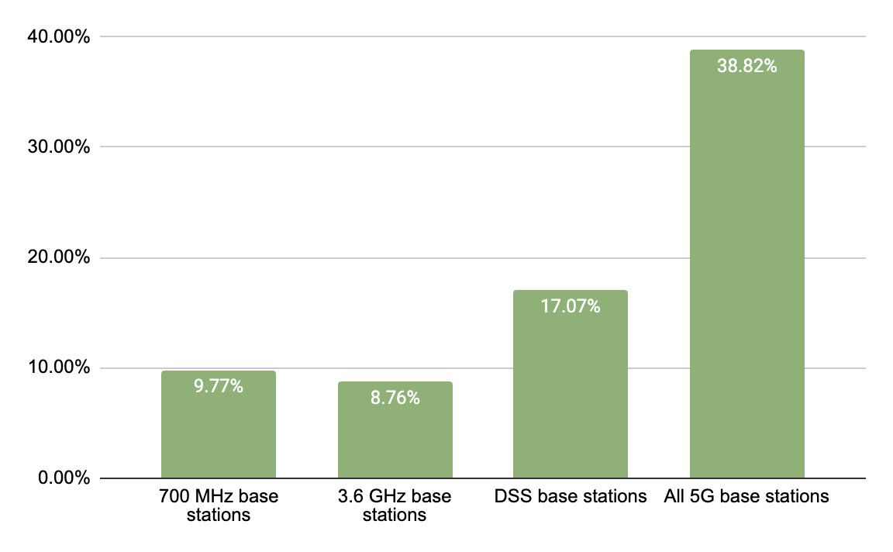
EU Scoreboard
81% 5G coverage of populated areas¹
71% of pioneer bands assigned on average in EU27 (Each pioneer band is weighed 1/3rd)³
Darker green indicates higher coverage
Reporting period: Up to end-2022; Next update planned for end-2023
5G deployment & coverage
5G spectrum assignments
Reporting period: Up to October 2023
354,000 5G base stations in EU27
5G base stations as a percentage of existing 4G base stations²
5G pioneer bands assigned across the EU27
Reporting period: Majority of entries collected between Aug. – Oct. 2023; see footnote for more detail
Reporting period: Up to October 2023
Notes:
Base station figures for Portugal updated in Dec 2023 after the initial publication of the report

Slide 3
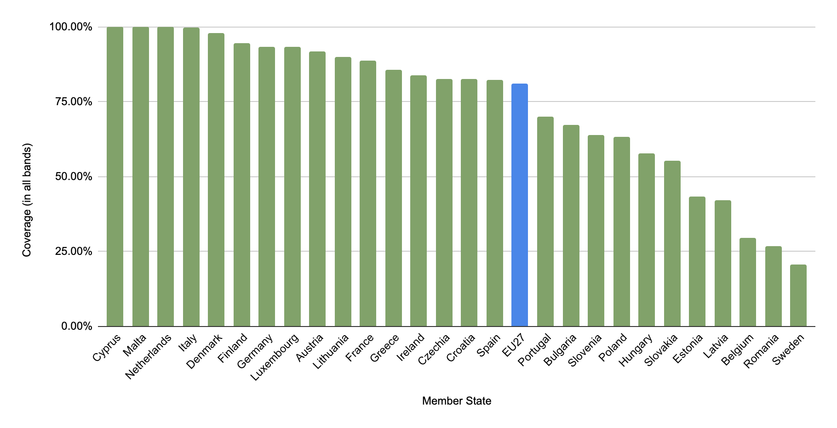
EU Scoreboard
5G coverage of populated areas (All frequency bands combined)⁴
EU 5G progress
Reporting period: Up to end-2022; Next update planned for end-2023

Slide 4
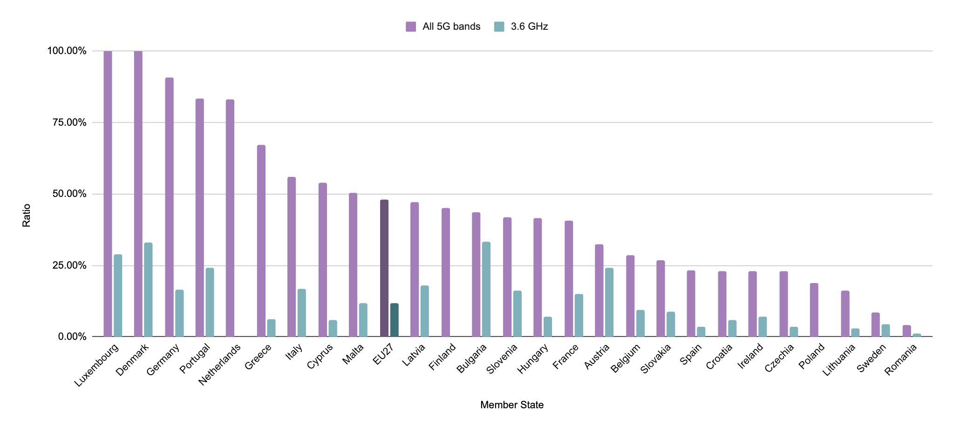
EU Scoreboard
5G base stations as a percentage of existing 4G base stations in Member States⁵
EU 5G progress
Reporting period: Majority of entries collected between Aug. – Oct. 2023; see footnote for more detail
Notes:
Figures for Portugal updated in Dec 2023 after the initial publication of the report

Slide 5
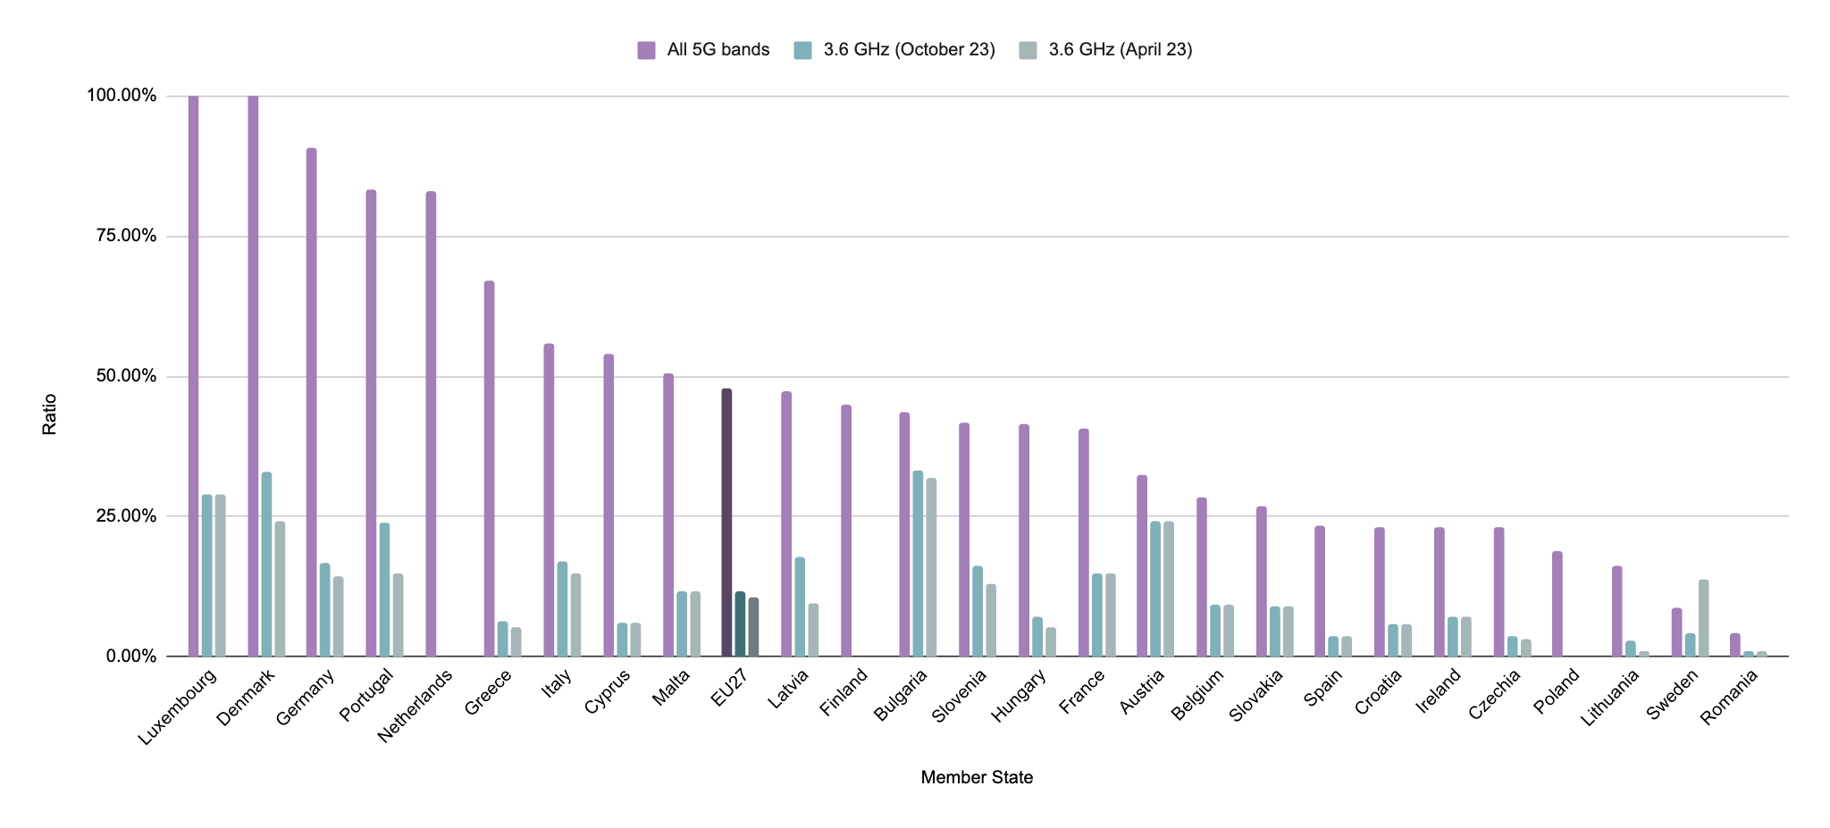
EU Scoreboard
5G base stations as a percentage of existing 4G base stations in Member States compared to previous bi-annual report⁵
EU 5G progress
Reporting period: Majority of entries collected between Aug. – Oct. 2023; see footnote for more detail
Notes:
Figures for Portugal updated in Dec 2023 after the initial publication of the report

Slide 6
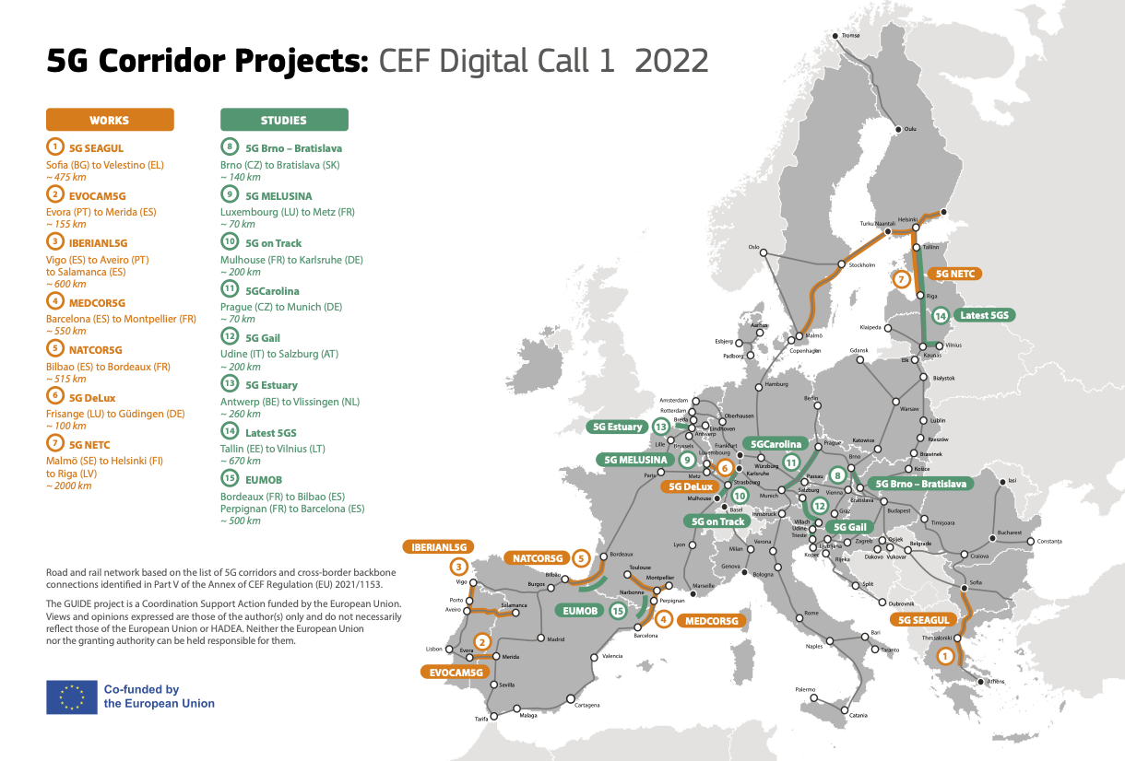
EU 5G Corridors
7 5G cross border works
8 5G cross border studies
5G Corridors
Reporting period: Up to end-2022

Slide 7
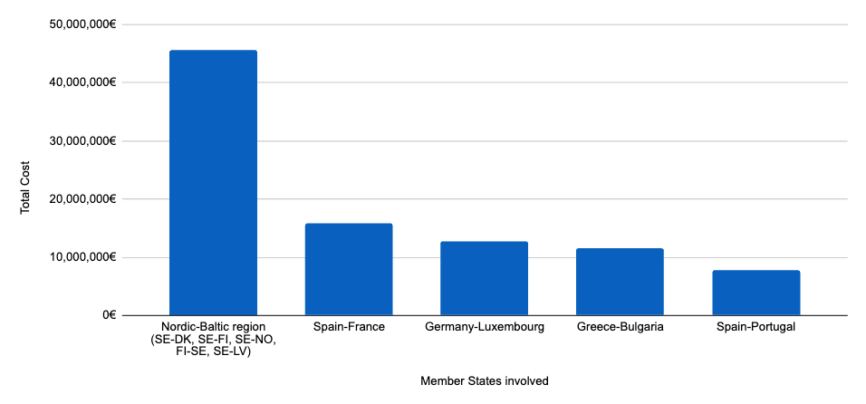
EU 5G Corridors
Committed investment in 5G cross-border deployment
5G Corridors
Reporting period: Up to end-2022

Slide 8
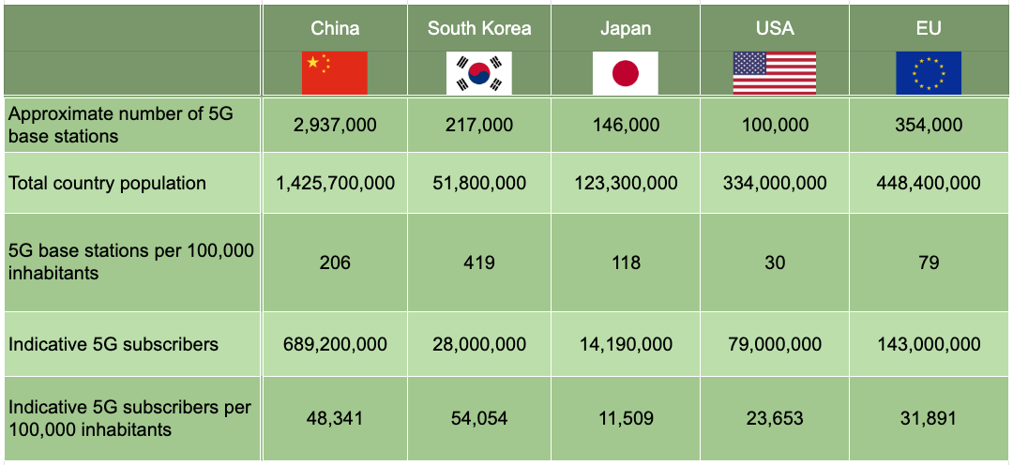
International Scoreboard
International Scoreboard
Comparison of 5G rollout in international markets⁶
5G rollout
Reporting period: 5G base station data collected between July 2022 – July 2023; Population data collected July 2023; 5G subscriber data collected between July 2022- July 2023

Slide 9
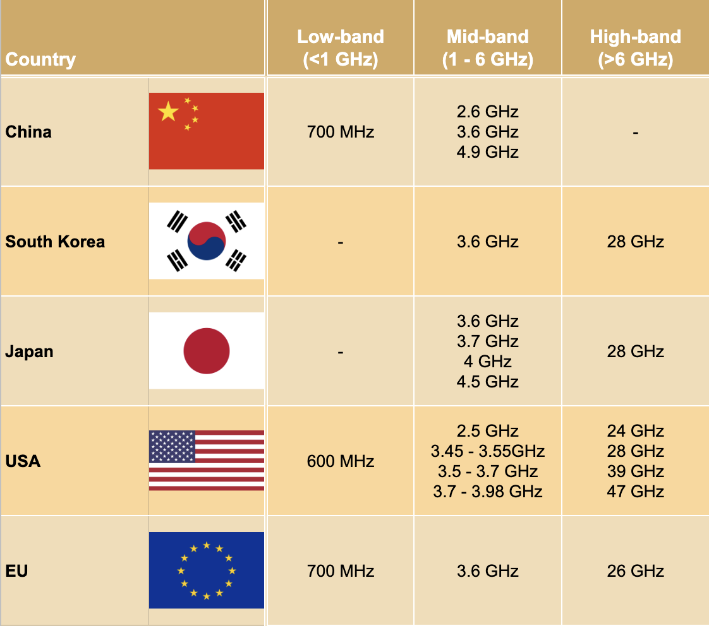
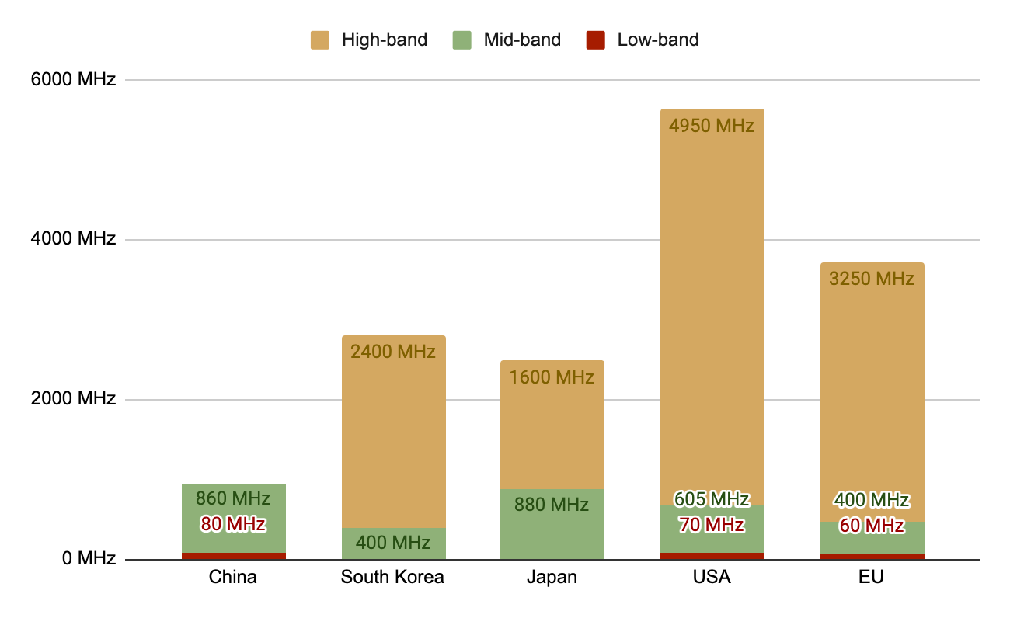
International Scoreboard
International Scoreboard
Main bands authorised for 5G in international markets⁷
Authorised 5G spectrum in international markets⁷
5G spectrum
Reporting period: Up to Sept. 2023

Slide 10
Footnotes
EU Scoreboard
5G coverage map
1 – This is a general indicator that does not presume any particular quality of service measures. All 5G coverage is included, including that using DSS. Location covered by at least one operator.
5G base stations as a percentage of existing 4G base stations
2 - For some EU countries, only the total number of 5G base stations is known. This means the true total number of base stations in the EU in 700 MHz, 3.6 GHz or DSS bands may be higher. Additionally, some countries use bands that are not included in this chart and do no operate using a DSS configuration.
Reporting period: Reporting period: The data for Bulgaria, Czechia, Denmark, Greece, Germany, Hungary, Italy, Lithuania, Latvia, Poland, Portugal, Romania, Slovenia and Sweden was collected between September - October 2023. The data for Austria, Belgium, Cyprus, Estonia, Netherlands, Croatia, Ireland, Malta, Slovakia and Spain was based on the latest available data from the January - March 2023. The data for Luxembourg was collected from the end of December 2022. The data for Finland and France was collected from the end of August 2022.
Source: 5G coverage of populated areas and spectrum assignment data is sourced from the DESI index; Base station data is from the European Commission, via the Digital Decade Committee which is the successor of the Communications Committee (COCOM)
5G spectrum assignments
3 –Countries need to assign 60 MHz in 700 MHz; 400 MHz in 3.6 GHz and at least 1000 MHz in 26 GHz to receive a 100% score.
4 - Percentage represents households covered by at least one 5G network.
International 5G rollout
5 - There may be discrepancies between the reported figures, as the method for calculating the number of base stations is not standardized between regions
Source: Data on subscriber numbers and base stations was collected from various sources including regulator announcements.
International 5G spectrum
6 - USA data shows all spectrum made available to mobile operators by the FCC. Not all of this spectrum will have been sold to operators so the final amount of spectrum assigned to operators may be slightly lower. For the EU spectrum assignments differ amongst EU Member States. Because of this, the number used in the scoreboard shows how much spectrum has been harmonized at an EU-level. Some individual countries may have more spectrum assigned for 5G, while some may have less.
Source: Data on international spectrum assignments is sourced from the Policy Tracker database, the DESI index as well as FCC data.

