Slide 1
5th 5G Observatory Stakeholder workshop
26 October 2023
CNECT/2021/OP/0008 European 5G Observatory, Phase III

Slide 2
Recent developments: Spectrum policy
Date | Country | Spectrum awarded
Nov. 2022 | Estonia | 700 MHz
Nov. 2022 | Romania | 700 MHz 1500 MHz 2.6 GHz 3.6 GHz
Dec. 2022 | Ireland | 700 MHz 2.1 GHz 2.3 GHz 2.6 GHz
Jan. 2023 | Spain | 26 GHz
March 2023 | Croatia | 800 MHz 900 MHz 1800 MHz 2.1 GHz 2.6 GHz 3.6 GHz*
May 2023 | Estonia | 26 GHz
Sept.2023 | Sweden | 900 MHz 2.1 GHz 2.6 GHz
Oct. 2023 | Poland | 3.6 GHz
Recent developments: Spectrum policy
Various spectrum auctions took place
All Member States have now assigned at least one pioneer band, and the majority have assigned at least two (24 MS total)
26 GHz remains unpopular: Only 11 MSs have assigned band
Local 5G licensing models continue to be proposed (Poland, Slovenia)
*Regional licenses

Slide 3
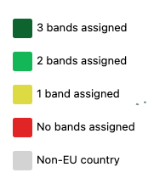
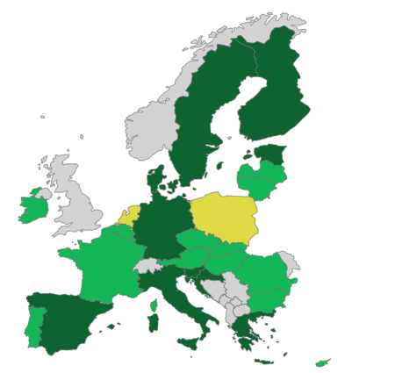
Recent developments: Spectrum policy
Pioneer bands assigned in the EU (700 MHz; 3.6 GHz; 26 GHz)
October 2022
October 2023
62% assigned
71% assigned

Slide 4
Recent developments: Policy
Recent developments: Policy
June 2023: New 5G Key Performance Indicators (KPIs) announced by Commission
New KPIs will measure the percentage of households that receive a 5G signal independent of the operator or service quality
Ongoing effort by the Digital Decade Committee to improve this metric in the future
5G cross-border progress
January 2023: 15 cross-border project winners announced as part of 1st call of Connected Europe Facility (CEF)
Winners of the 2nd call will be announced end of November
3rd call open now until January 2024
Public 5G/6G funding continues
January 2023: France issues €750 million call for 5G and 6G projects
March 2023: Belgium funds 21 pilot 5G projects
May 2023: Lithuania allocates €24.5 million for 5G projects
June 2023: Spain makes €500 million available for rural 5G

Slide 5
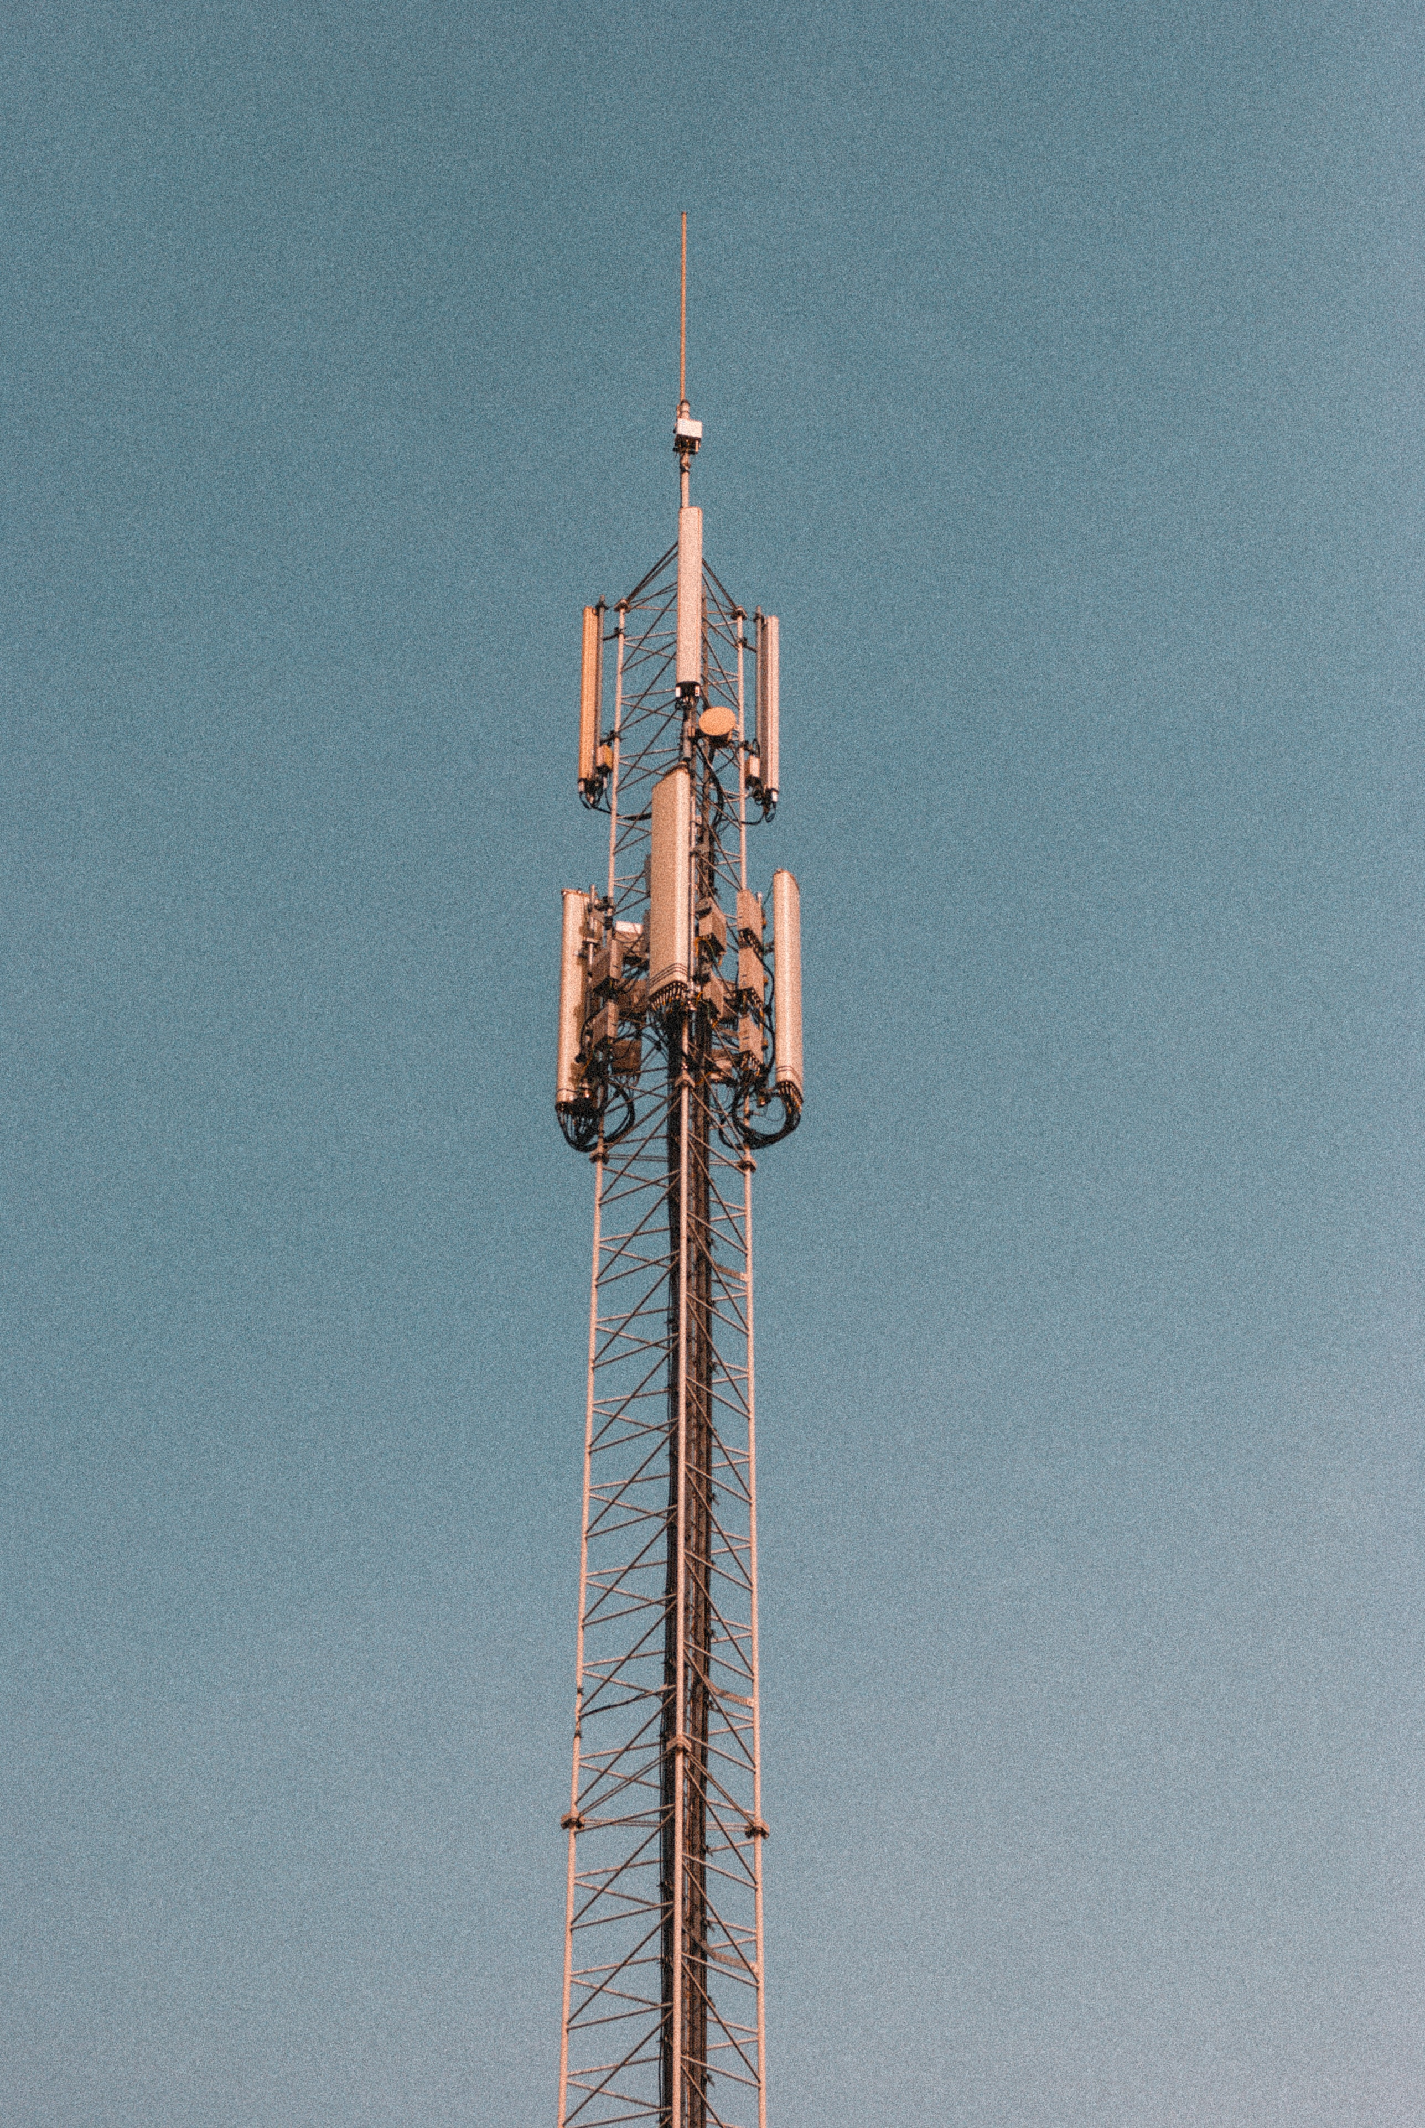
Recent developments: Commercial
Recent developments: Commercial
Average 5G coverage now stands at 81% (by at least one operator)
Operators are increasing coverage and investing in new technologies
Vodafone & Telefonica Germany claim 90% 5G coverage (Deutsche Telekom 95%)
Telia group 5G coverage at 84% across its six European markets
However, end-user 5G experience varies
No reliable data on standalone 5G
Difficult to measure the quality of 5G networks
Photo by Julian on Unsplash

Slide 6
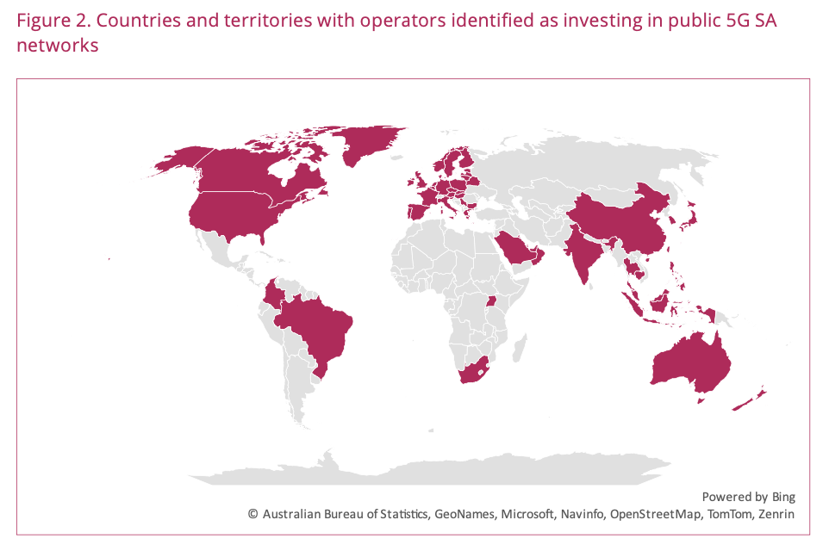
Major international developments
Major international developments
The 5G Observatory also keeps track of major international 5G developments
Growing interest in standalone 5G (SA) and network slicing
GSA: 121 operators in 55 countries investing in 5G SA (47 operators have launched 5G SA)
August 2023: US-based T-Mobile launches network slicing beta
Indian MNO Jio to use network slicing for 5G fixed wireless access (FWA)
Rapid 5G growth in India: Department of Telecommunications claims over 300,000 base stations only a few months after spectrum auction
Source: GSA
Notes:
https://gsacom.com/paper/5g-standalone-october-2023-member-report/

Slide 7
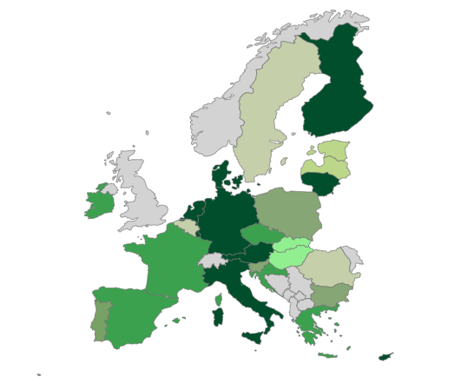
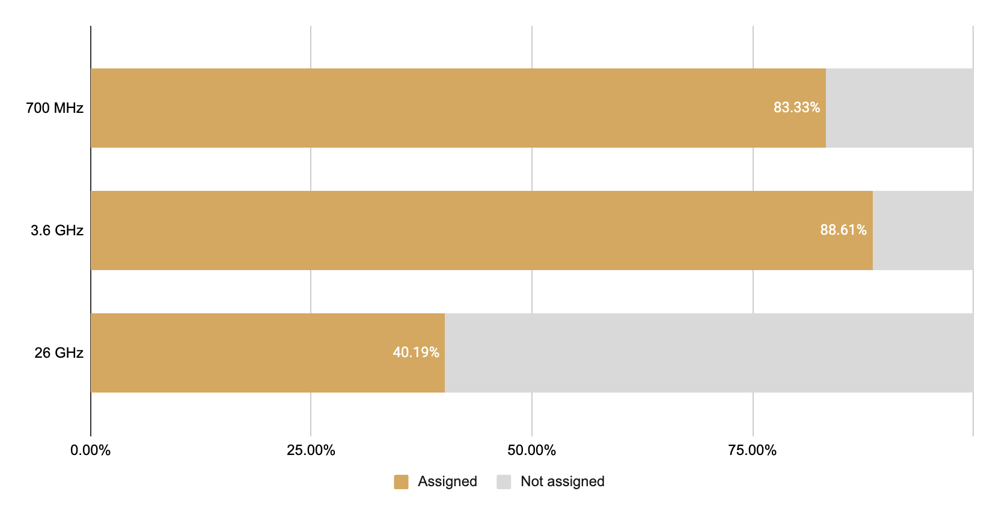
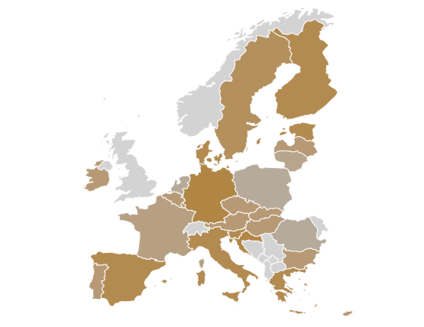
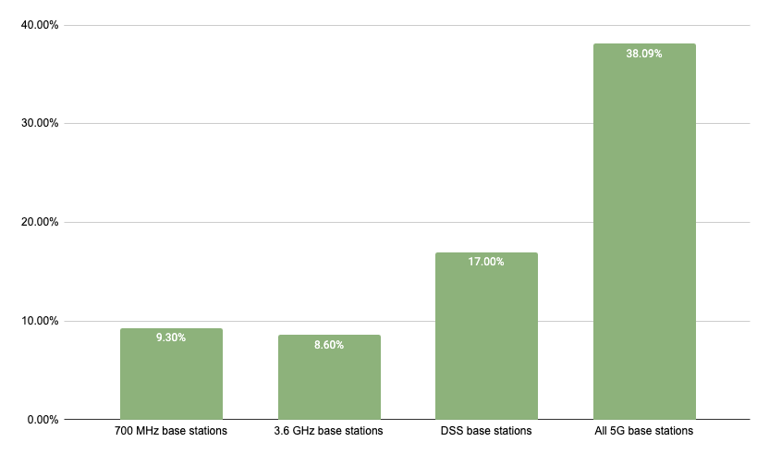
EU Scoreboard
81% 5G coverage of populated areas¹
71% of pioneer bands assigned on average in EU27 (Each pioneer band is weighed 1/3rd)³
Darker green indicates higher coverage
Reporting period: Up to end-2022
5G spectrum assignments
5G deployment & coverage
Reporting period: Up to October 2023
346,000 5G base stations in EU27
5G base stations as a percentage of existing 4G base stations²
5G pioneer bands assigned across the EU27
Reporting period: Majority of entries collected between Aug. – Oct. 2023; see footnote for more detail
Reporting period: Up to October 2023

Slide 8
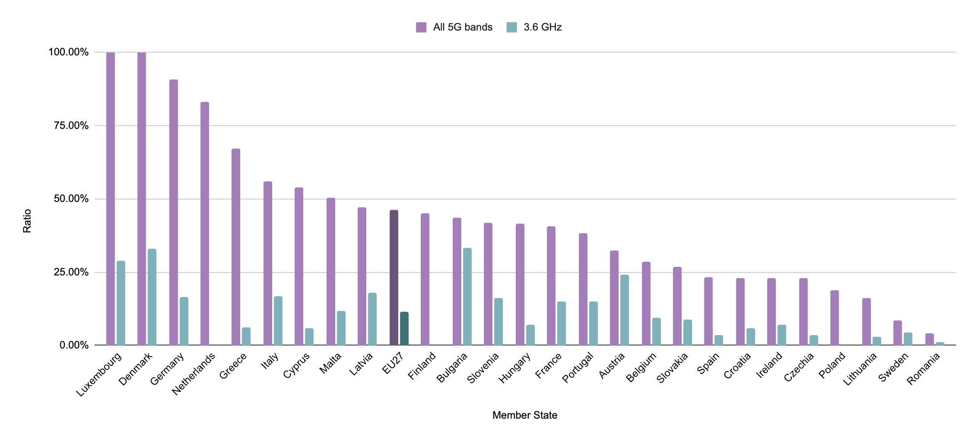
EU Scoreboard
5G base stations as a percentage of existing 4G base stations in Member States⁵
EU 5G progress
Reporting period: Majority of entries collected between Aug. – Oct. 2023; see footnote for more detail

Slide 9
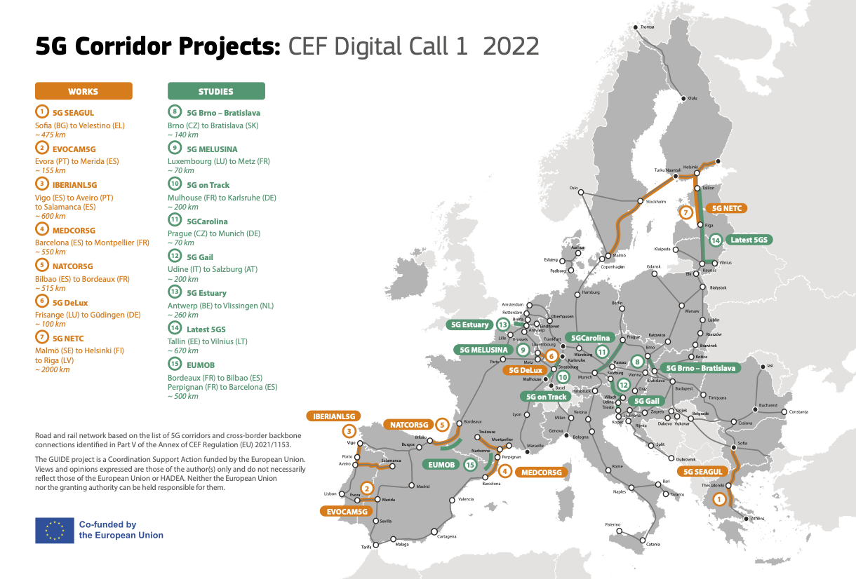
7 5G cross border works
8 5G cross border studies
5G Corridors
Reporting period: Up to end-2022

Slide 10
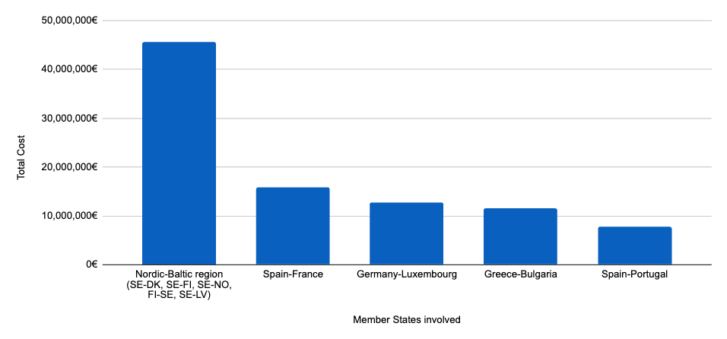
EU 5G Corridors
Committed investment in 5G cross-border deployment
5G Corridors
Source: European Commission
Reporting period: Up to end-2022

Slide 11
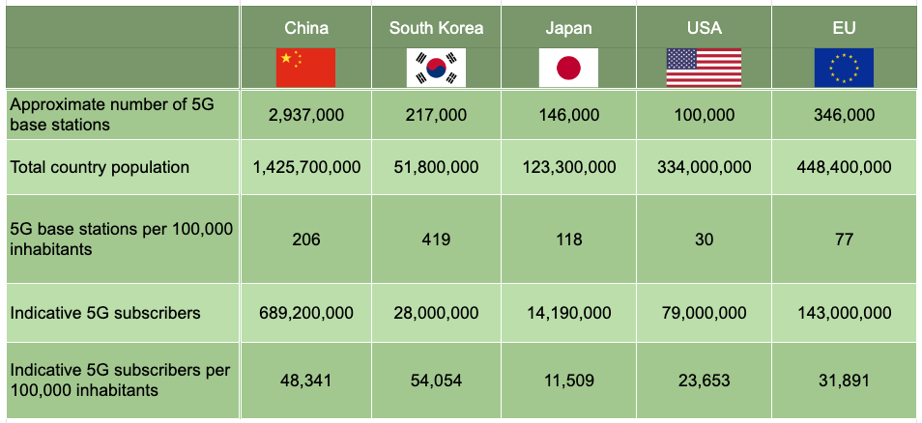
International Scoreboard
International Scoreboard
Comparison of 5G rollout in international markets⁶
5G rollout
Reporting period: 5G base station data collected between July 2022 – July 2023; Population data collected July 2023; 5G subscriber data collected between July 2022- July 2023

Slide 12
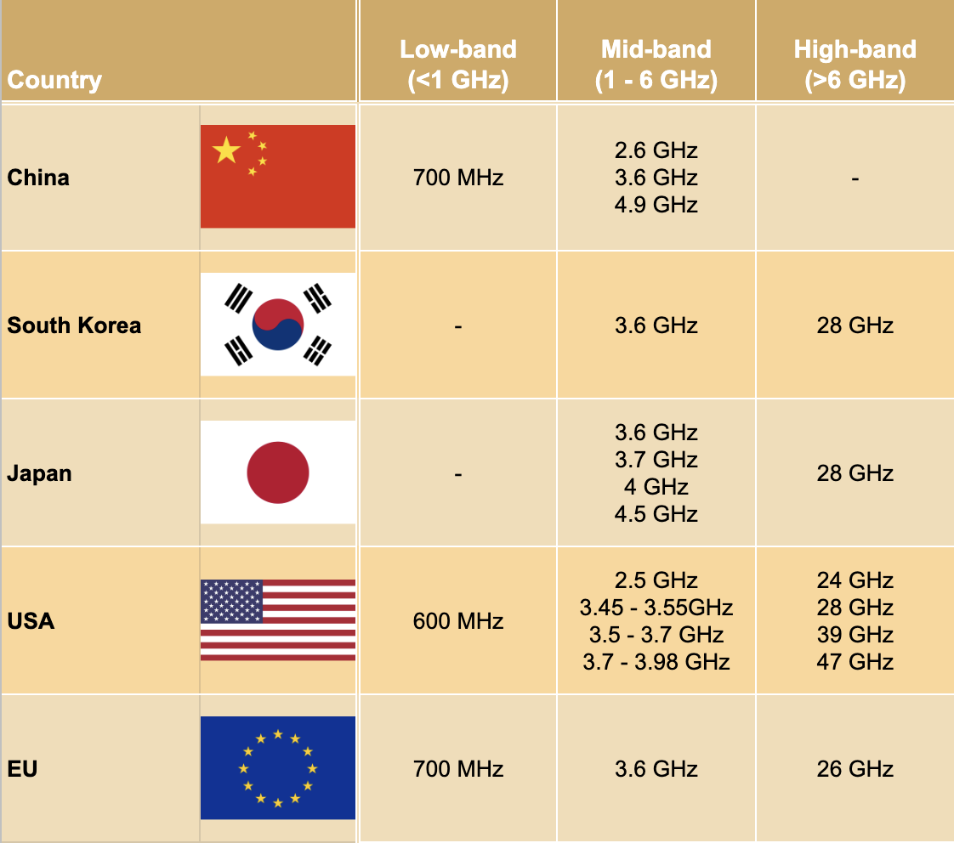
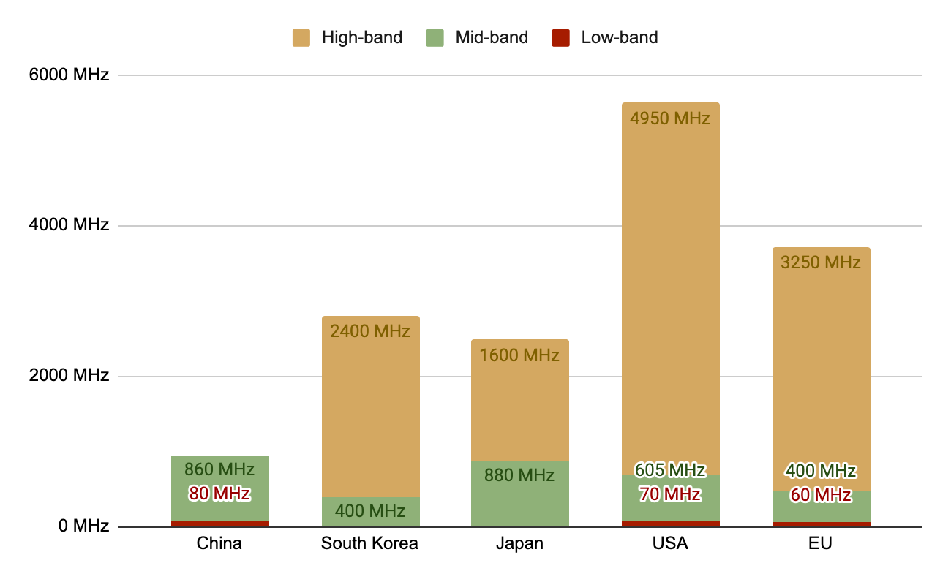
International Scoreboard
International Scoreboard
Main bands authorised for 5G in international markets⁷
Authorised 5G spectrum in international markets⁷
5G spectrum
Reporting period: Up to Sept. 2023

Slide 13
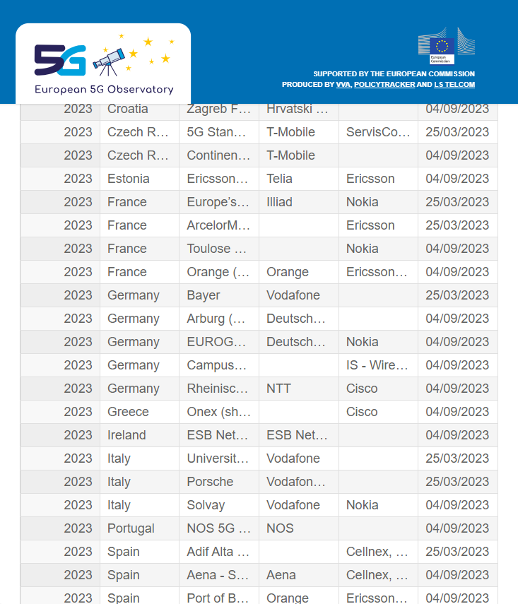
5G Private networks update EU
The Observatory maintains a non-exhaustive list of private 5G networks which is based on research of publicly available information.
The Observatory team endeavour to obtain as much information on published private 5G network deployments as possible. The analysis from the last quarterly report can be found on the website here.
An overview of 5G private networks featuring a searchable table (on the right) of major private network projects in the EU can be found here.
Research the latest public announcements of private 5G networks in EU countries
Public search yields announcements from major vendors (e.g. Ericsson, Nokia), telco involvement or verticals themselves
The 5G Observatory’s list of networks includes a short summary including the main applications being supported

Slide 14
5G Private networks update EU
Deployment of 5G private networks has continued to increase across EU countries in the past 12 months.
A total of 94 networks with Germany (20), France (13) and Finland (8) as leading MSs
Demand for these private networks is based on the need for dedicated secure services to private enterprises such as factories, plants, large campuses, ports and airports
DISCLAIMER: There are more 5G private networks deployed in practice, noting the data is based on search of publicly announced deployments and subject to continuous change.

Slide 15
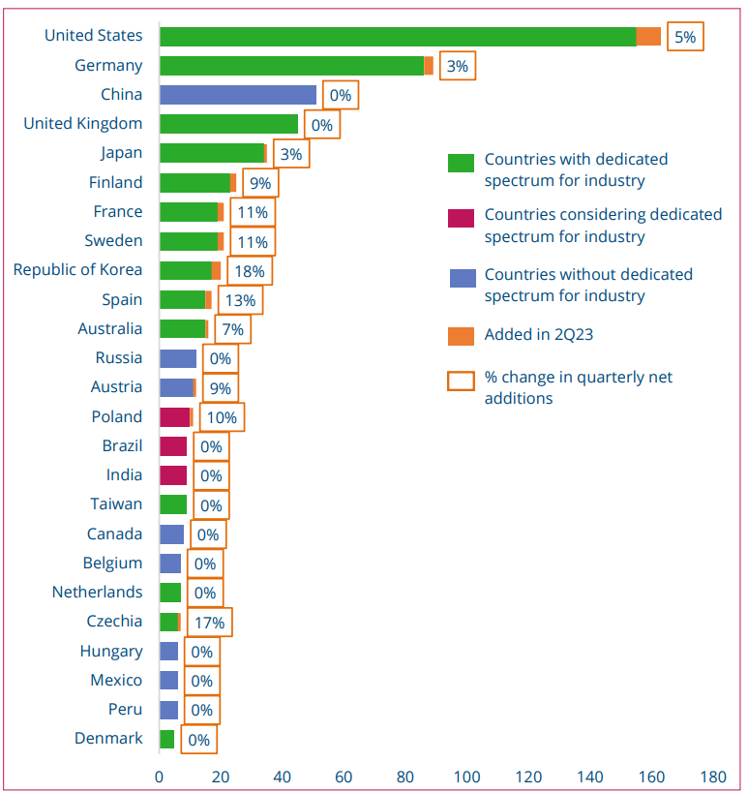
EU = 37% of global (GS) deployments
5G Private networks update EU
Outside of the EU, countries including Japan, UK, China and the USA have a large proportion of total 5G private networks globally (Source: GSA)
Our research indicates that 5G private networks are being deployed in dedicated spectrum (e.g Germany)
Some current 4G networks will be upgraded to 5G in due course
Many of the applications being deployed include:
High-definition video links
Low latency comms for vehicle control
Industry 4.0 applications
Secure, predictable and accessible wireless digital infrastructure
A key attribute is 5G private networks are independent of loads on public or unlicensed networks
Source: Private Mobile Networks, September 2023, GSA Total Global deployments = 676

Slide 16
5G Private networks update EU
Nokia and Ericsson are the main vendors deploying 5G private networks in the EU
Telcos deploying 5G private networks include Vodafone, Deutsche Telekom, Telefonica, T-Mobile, A1 Austria, Proximus, Orange, TDC Net and B2B operator CityMesh among others
In most of the telco-deployed networks, MNOs are using their 5G spectrum (mostly in 3.4 – 3.8 GHz); in some cases the initial deployment is using 4G and equipment is ‘5G-ready’

Slide 17
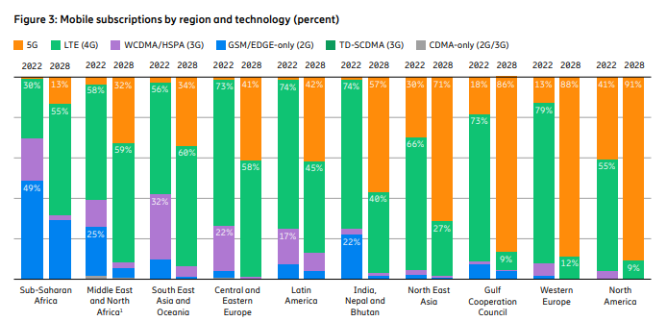
5G Deployment Forecasting progress towards 2025
ERICSSON, Mobility Report, June 2023. Scope: Global – BR 19
Western Europe
4G technology is reported to be still dominant in Western Europe, with the subscription penetration reaching 79% at the end of 2022. 5G subscriptions experienced strong growth, moving from 32 million in 2021 to 69 million at the end of 2022. 5G subscriptions are expected to reach 143 million by the end of 2023 (a reduction of 7 million by comparison to last year's forecast), with a subscription penetration projected to reach 88% by 2028.
Central and Eastern Europe
In Central and Eastern Europe, the uptake is slower due to both the reluctance of consumers to upgrade to more expensive subscriptions and slower spectrum allocation processes. 4G subscriptions accounted for 73% of the market at the end of 2022, but the growth has flattened and should be close to zero until 2025. Nevertheless, from 2025 onwards, only 5G subscriptions are projected to be growing.
Source:
Ericsson, Mobility Report, 2023
Notes:
Introduction:
This part features a summary of existing projections for the forecasting towards 2025 5G-related targets and, in some cases, even later. The reports here cover in the period of the last 12 months from the latest workshop.
Text:
In the June 2023 update of the Ericsson Mobility Report, 4G technology is reported to be still dominant in Western Europe, with the subscription penetration reaching 79% at the end of 2022. Nonetheless, 5G subscriptions experienced strong growth, from 32 million in 2021 to 69 million at the end of 2022. 5G subscriptions are expected to reach 143 million by the end of 2023, with a subscription penetration projected to reach 88% by 2028.
Meanwhile, in Central and Eastern Europe, the uptake is slower due to both the reluctance of consumers to upgrade to more expensive subscriptions and slower spectrum allocation processes. 4G subscriptions accounted for 73% of the market at the end of 2022, but the growth has flattened and should be close to zero until 2025. Nevertheless, from 2025 onwards, only 5G subscriptions are projected to be growing.

Slide 18
5G Deployment Forecasting progress towards 2025
GSMA, The Mobile Economy, 2023. Scope: Global – BR 18
In 2022, 5G technology comprised 11% of the market in Europe, representing an increase from the 4% figure in 2021, whereas 4G still accounted for 75% of the market. By 2030, 5G uptake is projected to grow to 87% with a reduced 4G market share of 13%. Furthermore, overall mobile subscriber penetration is expected to only marginally increase from 90% in 2022 to 92% by 2030, accompanied by a moderate rise in smartphone adoption from 81% in 2022 to 91% by 2030.
Source: GSMA, The Mobile Economy Report, 2023
Notes:
Text:
According to the latest GSMA’s Mobile Economy report from February 2023, in 2022, 5G technology constituted 11% of the market in Europe, representing an increase from the 4% figure in 2021. Meanwhile, 4G still accounted for 75% of the market. By 2030, 5G uptake is projected to grow to 87% with a reduced 4G market share of 13%.
Furthermore, overall mobile subscriber penetration is expected to only marginally increase from 90% in 2022 to 92% by 2030, accompanied by a moderate rise in smartphone adoption from 81% in 2022 to 91% by 2030.

Slide 19
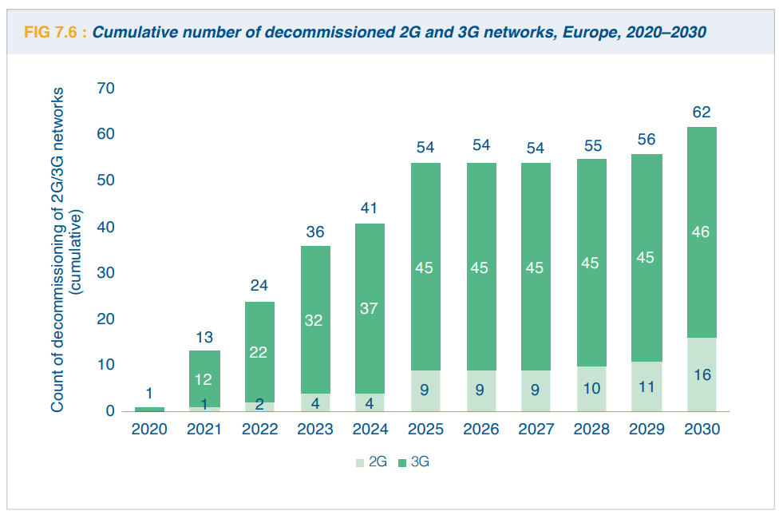
Next generation networks contribution to reaching Green Deal targets and addressing sustainability issues
Commitments taken up by the industry to reduce emissions and the role of 5G in the context of the targets set by the Green Deal
ETNO (European Telecommunications Network Operators’ Association): State of the Digital Communications 2023 – BR 18
ETNO emphasised the focus on the greening of telecoms networks through the transition toward next-generation networks.
4G and 5G networks are more energy efficient and, thus, their rollout is crucial for reducing energy usage. Most ETNO members are planning to shut off their 3G networks by 2028 and 2G networks will follow thereafter due to their importance for IoT functions and basic voice services.
Five decommissioning dates per year were announced for legacy networks (PSTN) in 2017. This is due to increase to 10 in 2023 and 2024 and 11 in 2025–2030.
Source: Analysys Mason, 2022, as reported in ETNO, State of the Digital Communications, 2023
Notes:
Introduction:
Sustainability is another key topic accompanying 5G development. This part provides a brief overview of commitments taken up by the industry to reduce emissions and the role of 5G in the context of the Green Deal targets. Following from the Commission’s Green Deal Communication, digital technologies were highlighted as a critical enabler for attaining the sustainability goals set by the Green Deal in many different sectors. The communication introduced the intention to explore measures to ensure that digital technologies such as Artificial Intelligence, 5G, cloud and edge computing and Internet of Things can accelerate and maximise the impact of policies to deal with climate change and protect the environment.
Text:
As a part of the chapter on sustainability in their latest State of Digital Communications 2023, ETNO (European Telecommunications Network Operators’ Association) emphasised the focus on the greening of telecoms networks through the transition toward next-generation networks. Indeed, 4G and 5G networks are more energy efficient; thus, their rollout is crucial for reducing energy usage. Most ETNO members are planning to shut off their 3G networks by 2028 and 2G networks will follow after that due to their importance for IoT functions and basic voice services. Five decommissioning dates per year were announced for legacy networks in 2017. This increased to 10 dates in 2023 and 2024 and 11 dates in 2025 to 2030

Slide 20
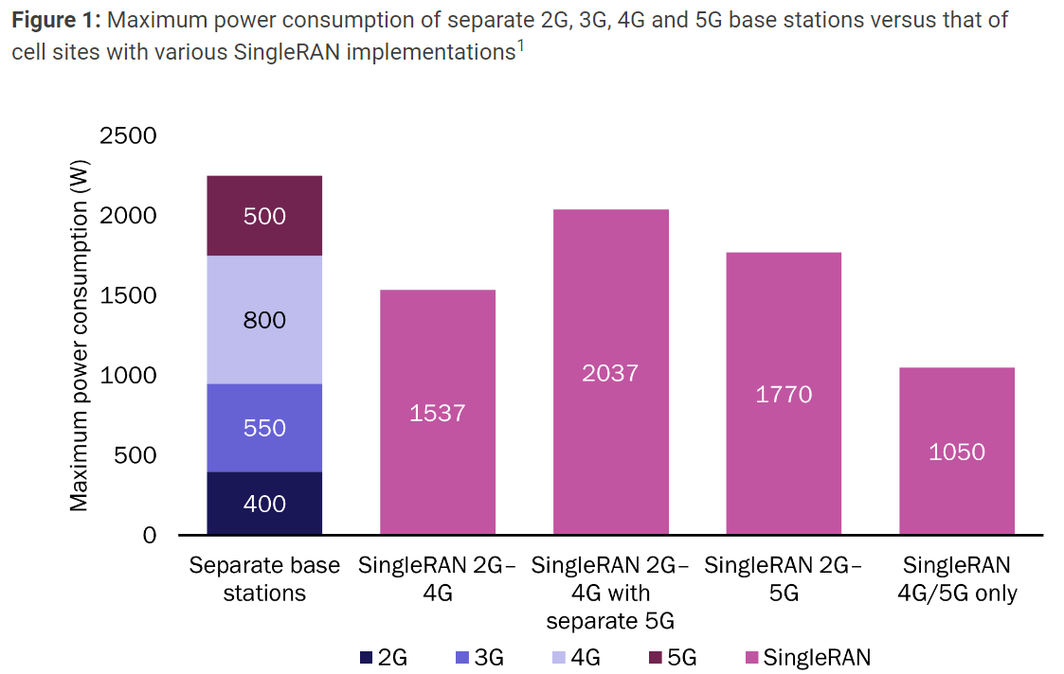
Next generation networks contribution to reaching Green Deal targets and addressing sustainability issues
Commitments taken up by the industry to reduce emissions and the role of 5G in the context of the targets set by the Green Deal
Analysis Mason: Decommissioning legacy networks will be key to reducing operators’ energy usage, 2022 – BR 18
Mobile network operators who are operating a full suite of 2G, 3G, 4G and 5G networks would be able to lower energy consumption by 40% by decommissioning 2G and 3G networks.
Similarly, transitioning from legacy fixed networks (PSTN, copper, local exchanges, FTTC and HFC) to an all-FTTP access network could reduce operators’ energy usage by up to 80%.
The upgrading process varies across fixed networks operators, featuring A1 Telekom Austria and Deutsche Telekom who has switched off PSTN, Telenor and Telefónica who will switch off their copper-based networks by 2025, and Proximus and KPN who are beginning to shut down their FTTC networks.
Source: Analysys Mason, 2022
Notes:
Text:
According to Analysis Mason, mobile network operators who are operating a full suite of 2G, 3G, 4G and 5G networks would be able to lower energy consumption by 40% by decommissioning 2G and 3G networks. Similarly, transitioning from legacy fixed networks to an all-FTTP (Fibre-to-the-Premise) access network could reduce operators’ energy usage by up to 80%. The upgrading process varies across fixed network operators.
For example, A1 Telekom Austria and Deutsche Telekom who have switched off PSTN (public switched telephone network),Telenor Sweden and Telefónica Spain who will switch off their copper-based networks by 2025, and Proximus Belgium and KPN Netherlands who are beginning to shut down their FTTC (Fibre-to-the-Cabinet) networks.

Slide 21
Next generation networks contribution to reaching Green Deal targets and addressing sustainability issues
Commitments taken up by the industry to reduce emissions and the role of 5G in the context of the targets set by the Green Deal
MWC (Mobile World Congress) Barcelona 2023 – QR 18
From the private sector, and in companion with the 2023 MWC, several major telcos announced initiatives toward more sustainable 5G networks.
Huawei launched their Eco series antennas, aiming to reduce site power consumption by 15%, as well as improving network energy efficiency, reducing OPEX and reducing carbon emissions. These antennas are supposed to bolster the development of green and high-performance 5G networks.
ZTE is pursuing a higher 5G network energy efficiency by way of their AAU hibernation or zero-load zero-carbon technology, which reduces the energy consumption of their zero-load equipment.
Ericsson showcased several new solutions in accordance with meeting their Net Zero ambitions during the MWC. The solutions focus on sustainability, energy saving and capacity expansion, and include portfolios such as new remote radios for 4G and 5G capacity, new mobile transport offerings and a new range of wideband Massive MIMO radios. All of which put an emphasis on lowering carbon emissions and site footprint.
Notes:
Text:
From the private sector, and in companion with the 2023 Mobile World Congress (MWC) last February, several major telecommunication companies announced initiatives toward more sustainable 5G networks.
For example, Huawei launched their Eco series antennas, aiming to reduce site power consumption by 15% and improve network energy efficiency, as well as reducing operating costs and carbon emissions. These antennas will boost the development of green and high-performance 5G networks. Similarly, ZTE is pursuing a higher 5G network energy efficiency through their AAU hibernation or zero-load zero-carbon technology, which reduces the energy consumption of their zero-load equipment. Another example is Ericsson who showcased several new solutions in accordance with meeting their Net Zero ambitions during the MWC. The solutions focus on sustainability, energy saving and capacity expansion. All of which put an emphasis on lowering carbon emissions and site footprint.

Slide 22
Thank you for your attention!

