Slide 1
5G Observatory Dashboard
April 2023 – Report 18
CNECT/2021/OP/0008 European 5G Observatory, Phase III

Slide 2
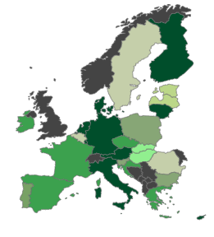
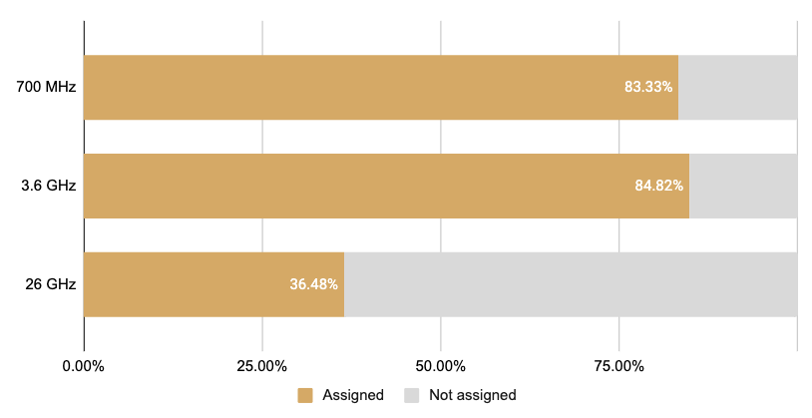
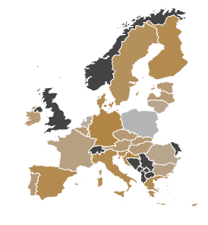
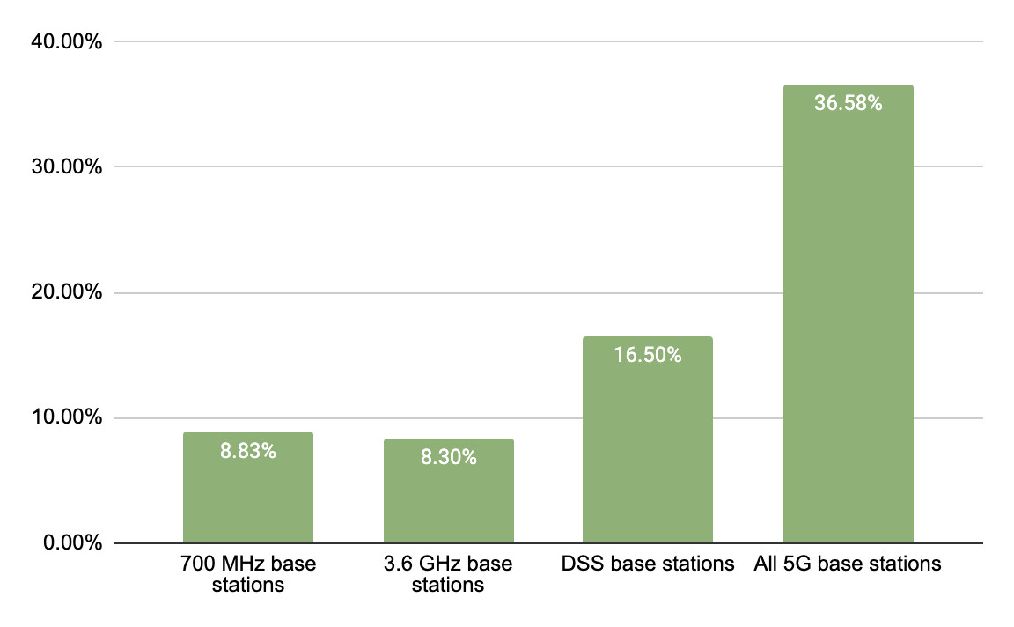
EU Scoreboard
81% 5G coverage of populated areas¹
68% of pioneer bands assigned on average in EU27 (Each pioneer band is weighed 1/3rd)³
Darker green indicates higher coverage
5G deployment & coverage
5G spectrum assignments
310,000 5G base stations in EU27
5G base stations as a percentage of existing 4G base stations²
5G pioneer bands assigned across the EU27
5G Observatory scoreboard - March 2023

Slide 3
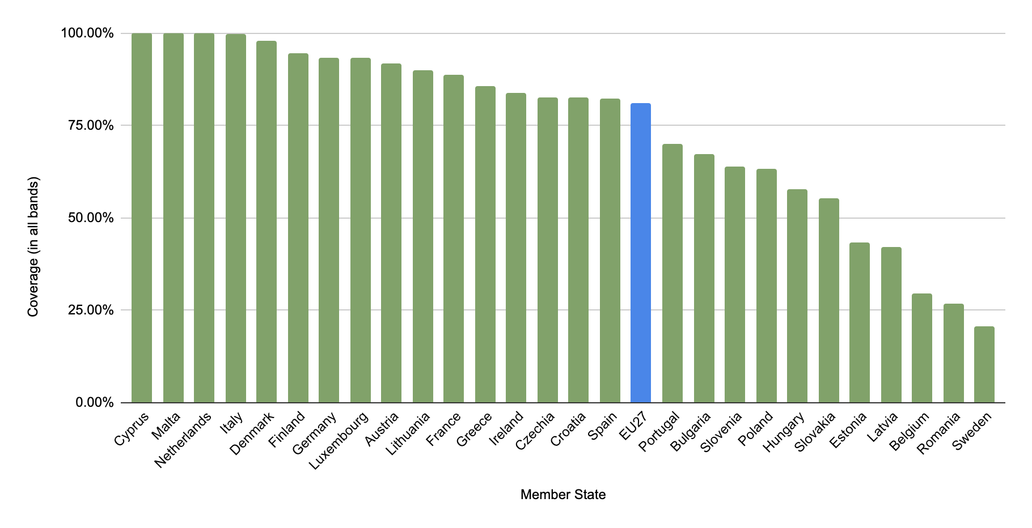
EU Scoreboard
5G coverage of populated areas (All frequency bands combined)⁴
EU 5G progress
5G Observatory scoreboard - March 2023

Slide 4
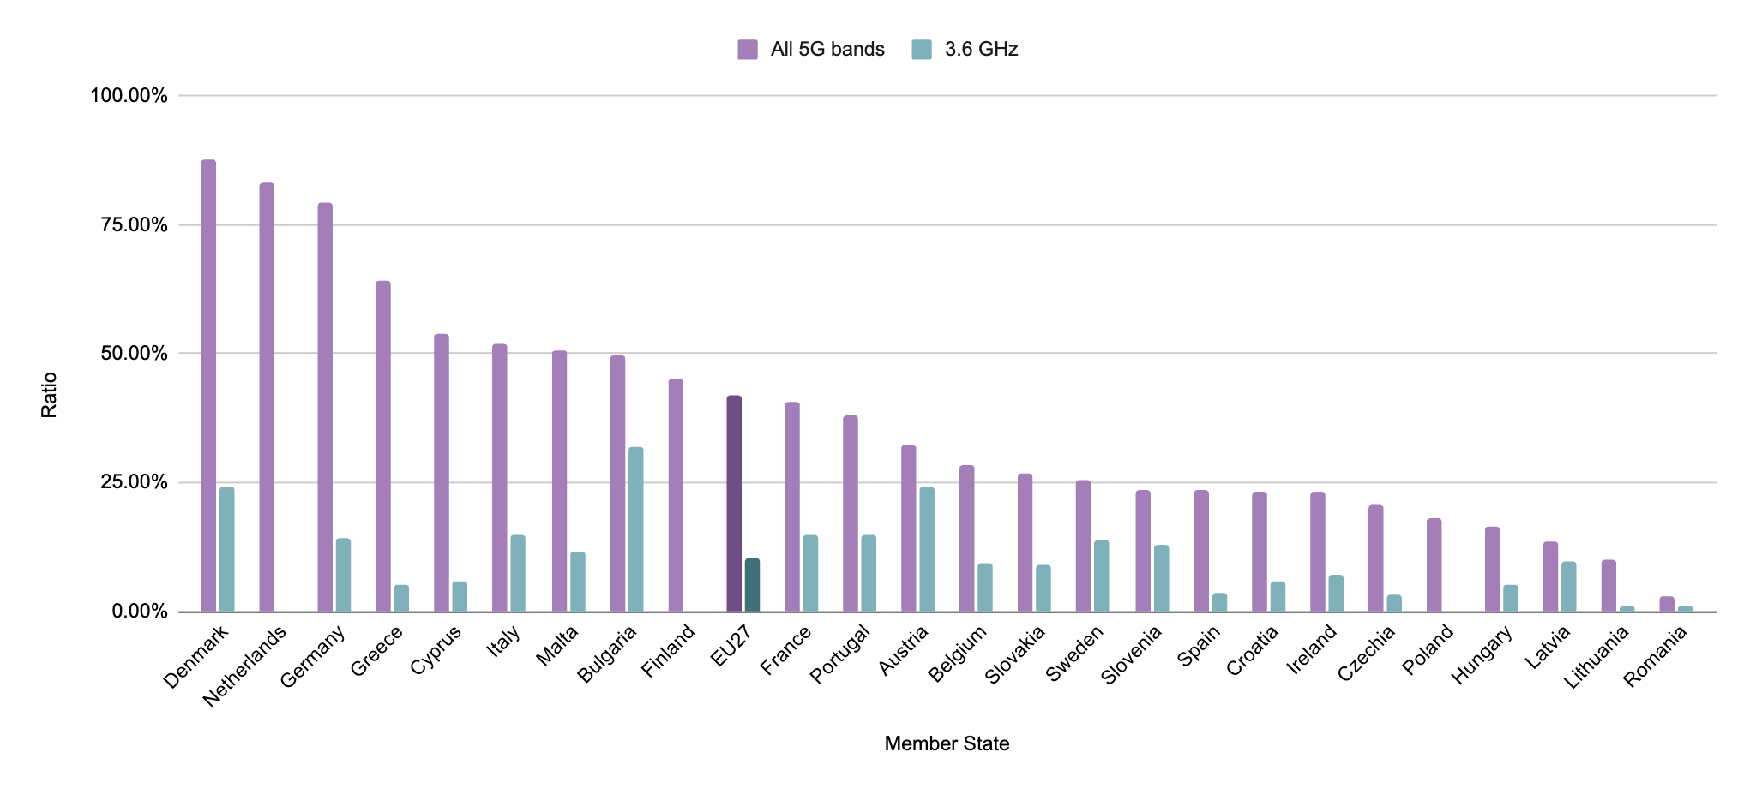
EU Scoreboard
5G base stations as a percentage of existing 4G base stations in Member States
EU 5G progress
5G Observatory scoreboard - March 2023

Slide 5
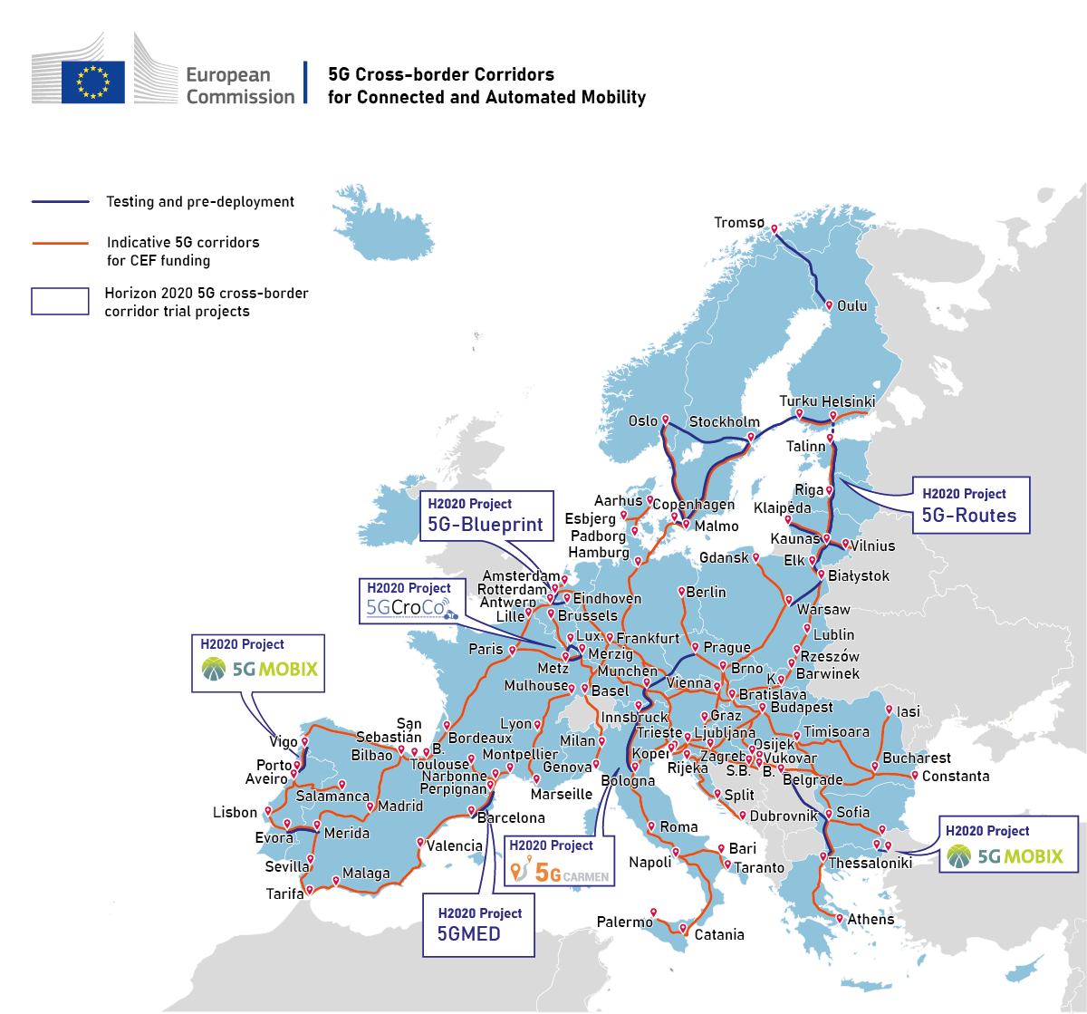
EU 5G Corridors
12 5G cross border corridors
5G Corridors
5G Observatory scoreboard - March 2023

Slide 6
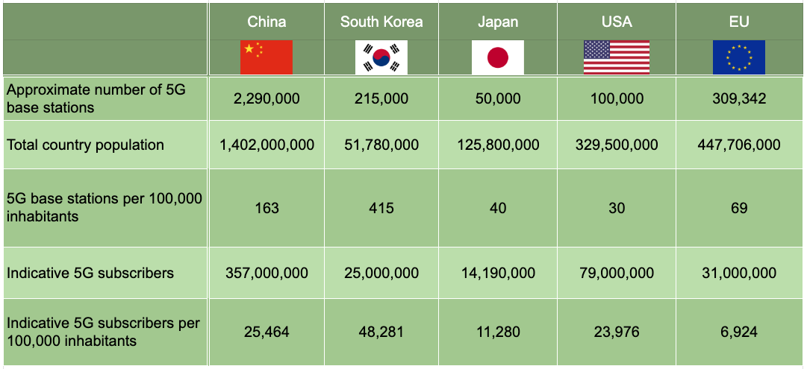
International Scoreboard
International Scoreboard
Comparison of 5G rollout in international markets⁵
5G rollout
5G Observatory scoreboard - March 2023

Slide 7
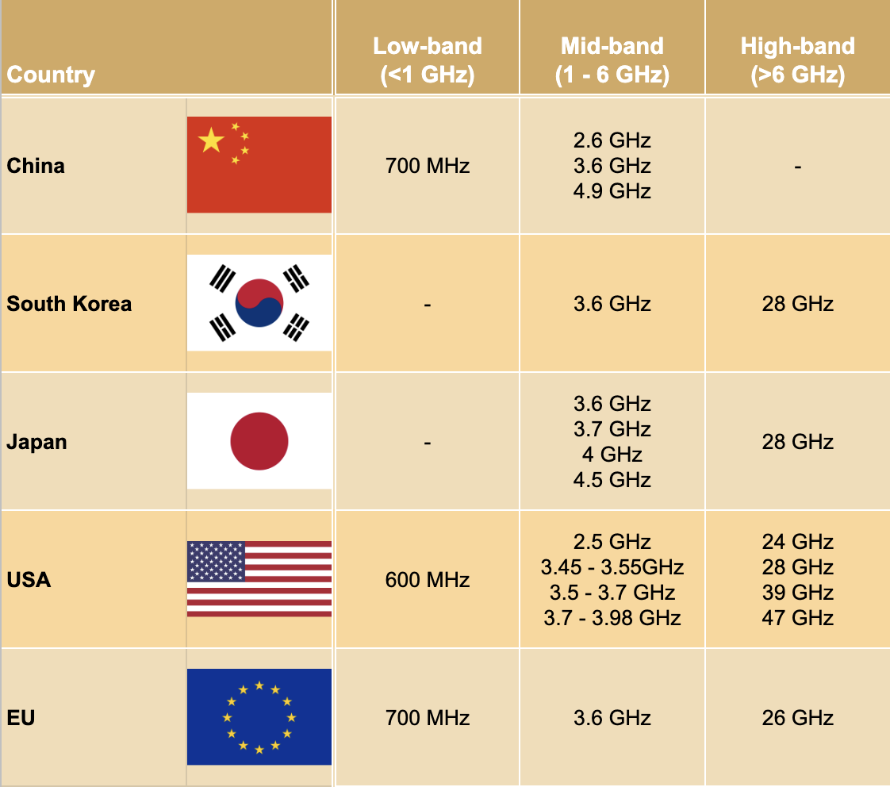
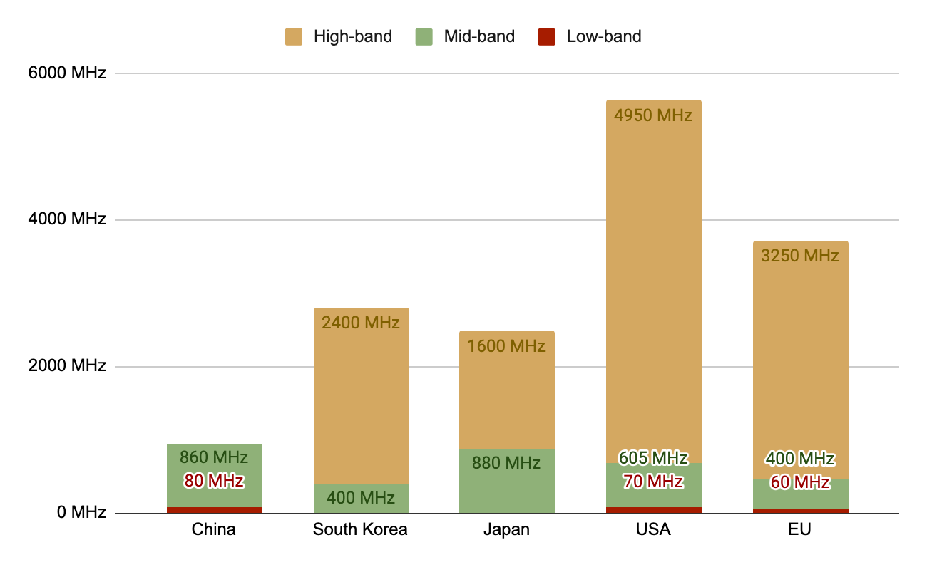
International Scoreboard
International Scoreboard
Main bands authorised for 5G in international markets⁶
Authorised 5G spectrum in international markets⁶
5G spectrum
5G Observatory scoreboard - March 2023

Slide 8
Footnotes
EU Scoreboard
5G coverage map
1 - Data was last updated in July 2022; this is a general indicator that does not presume any particular quality of service measures. All 5G coverage is included, including that using DSS. Location covered by at least one operator.
5G base stations as a percentage of existing 4G base stations
2 - For some EU countries, only the total number of 5G base stations is known. This means the true total number of base stations in the EU in 700 MHz, 3.6 GHz or DSS bands may be higher. Excludes Italy, Estonia, and Sweden as there was no base station data available. Additionally, some countries use bands that are not included in this chart and do no operate using a DSS configuration. In addition, the reference periods and number of base stations may vary for Member States due to the different timing of the provided data (e.g., end of 2022, Q1 of 2023)
Source: 5G coverage of populated areas and spectrum assignment data is sourced from the DESI index; Base station data is from the European Commission, via the Digital Decade Committee which is the successor of the Communications Committee (COCOM)
5G spectrum assignments
3 – Data was last updated in March 2023; Countries need to assign 60 MHz in 700 MHz; 400 MHz in 3.6 GHz and at least 1000 MHz in 26 GHz to receive a 100% score.
4 - Data was last updated in July 2022; Percentage represents households covered by at least one 5G network.
International 5G rollout
5 - There may be discrepancies between the reported figures, as the method for calculating the number of base stations is not standardized between regions
Source: Data on subscriber numbers and base stations was collected from various sources including regulator announcements.
International 5G spectrum
6 - USA data shows all spectrum made available to mobile operators by the FCC. Not all of this spectrum will have been sold to operators so the final amount of spectrum assigned to operators may be slightly lower. For the EU, the data on spectrum assigned has been averaged across all EU27. Some individual countries may have more spectrum assigned for 5G, while some may have less or none.
Source: Data on international spectrum assignments is sourced from the Policy Tracker database, the DESI index as well as FCC data.

